Slide 1
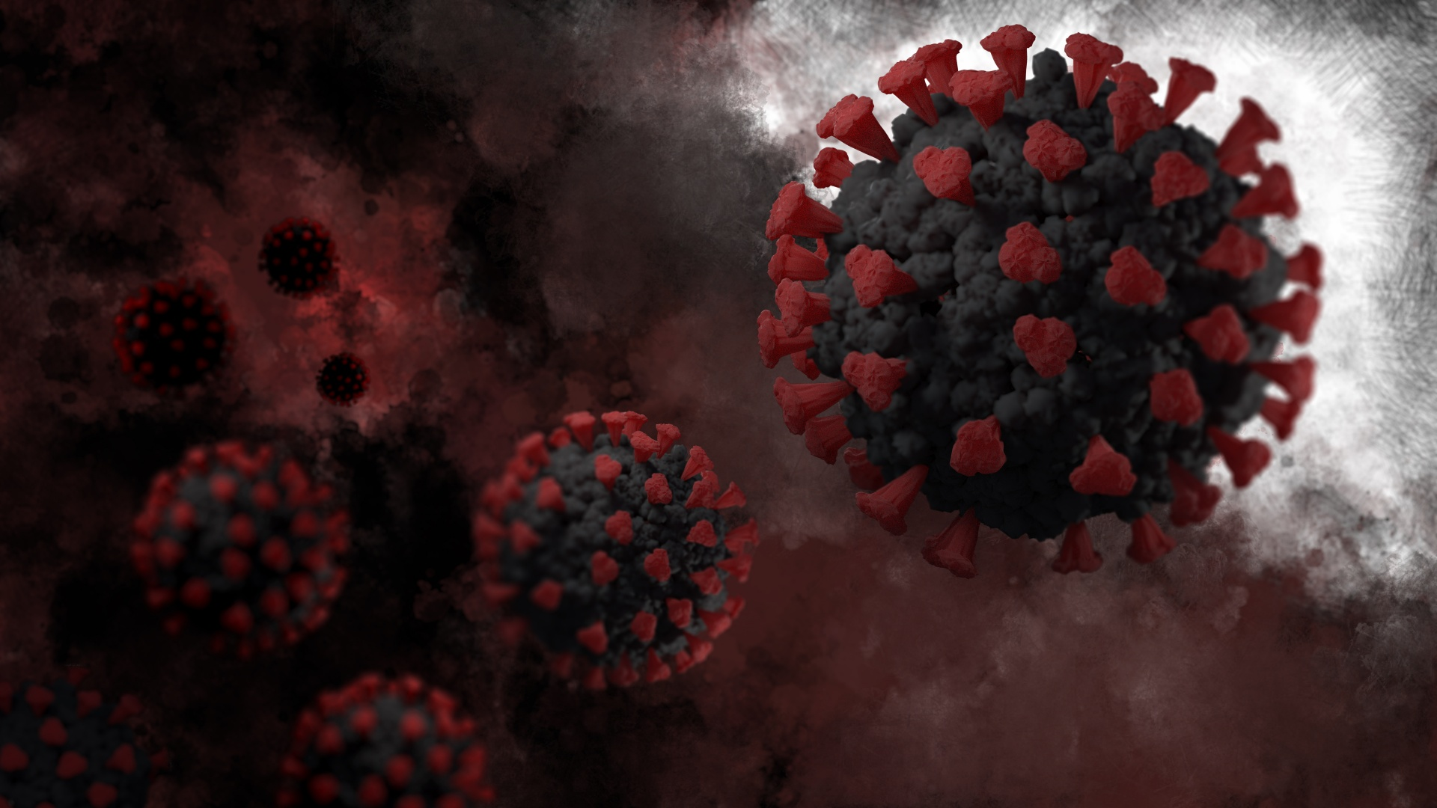
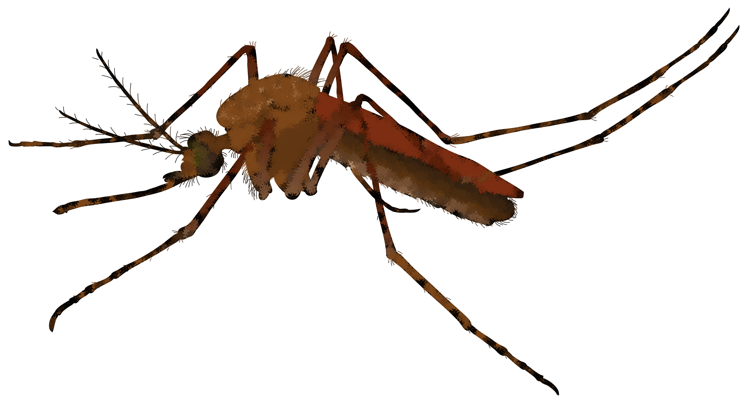
Yellow Fever and COVID-19
Day 3
This Photo by Unknown Author is licensed under CC BY-NC
This Photo by Unknown Author is licensed under CC BY-SA-NC

Slide 2
Fever: 1793 – Anatomy of an Epidemic
https://www.youtube.com/watch?v=uwPWgZJDdGE
Notes:
https://www.youtube.com/watch?v=uwPWgZJDdGE

Slide 3
Questions:
What are the symptoms of yellow fever?
Where did yellow fever come from?
What major event did the professor compare yellow fever to? Why?
This video was released in 2012. It’s 2021. What recent event can you compare this epidemic to? Why?
This Photo by Unknown Author is licensed under CC BY-NC
Notes:
Teachers should change the year if it’s no longer 2021.

Slide 4
Numbers in 1793
Philadelphia’s population = 50,000
Yellow fever deaths = 5,000
What percent of Philadelphia’s population died of yellow fever?
10%

Slide 5
Numbers Today
Philadelphia’s population = ?
Check www.census.gov:
1,584,064
10% of Philadelphia in 1793 died of yellow fever.
What is 10% of Philadelphia’s population today?
158,406.4
Notes:
Teachers may change the numbers if there is an update.
www.census.gov

Slide 6
1793 vs. Today
Population = 50,000
10% of population = 5,000
Population = 1,584,064
10% of population = 158,406.4
Notes:
Teachers may change the numbers if there is an update.

Slide 7
COVID-19 Numbers
Philadelphia’s population = 1,584,064
COVID deaths in Philadelphia = ?
Check www.nytimes.com/interactive/2020/us/pennsylvania-coronavirus-cases.html:
3,129
Notes:
Teachers may change the numbers if there is an update.
www.nytimes.com/interactive/2020/us/pennsylvania-coronavirus-cases.html

Slide 8
COVID-19 Numbers
Philadelphia’s population = 1,584,064
COVID deaths in Philadelphia = 3,129
What percent of Philadelphia’s population died of COVID?
0.2%
Notes:
Teachers may change the numbers if there is an update.

Slide 9
Yellow Fever vs. COVID-19
Population = 50,000
0.2% of population = 100
10% of population = 5,000
Population = 1,584,064
0.2% of population = 3,129
10% of population = 158,406.4
Notes:
Teachers may change the numbers if there is an update.

Slide 10
What do these numbers tell you about the severity of yellow fever in 1793?

Slide 11
What do these numbers tell you about the public health measures of COVID-19?

Slide 12
What other factors can you use to compare yellow fever and COVID-19?
Symptoms
Treatment
Prevention

Slide 13
Create a Chart
In pairs, compare yellow fever and COVID-19 based on their symptoms, treatment, and prevention.

Slide 14
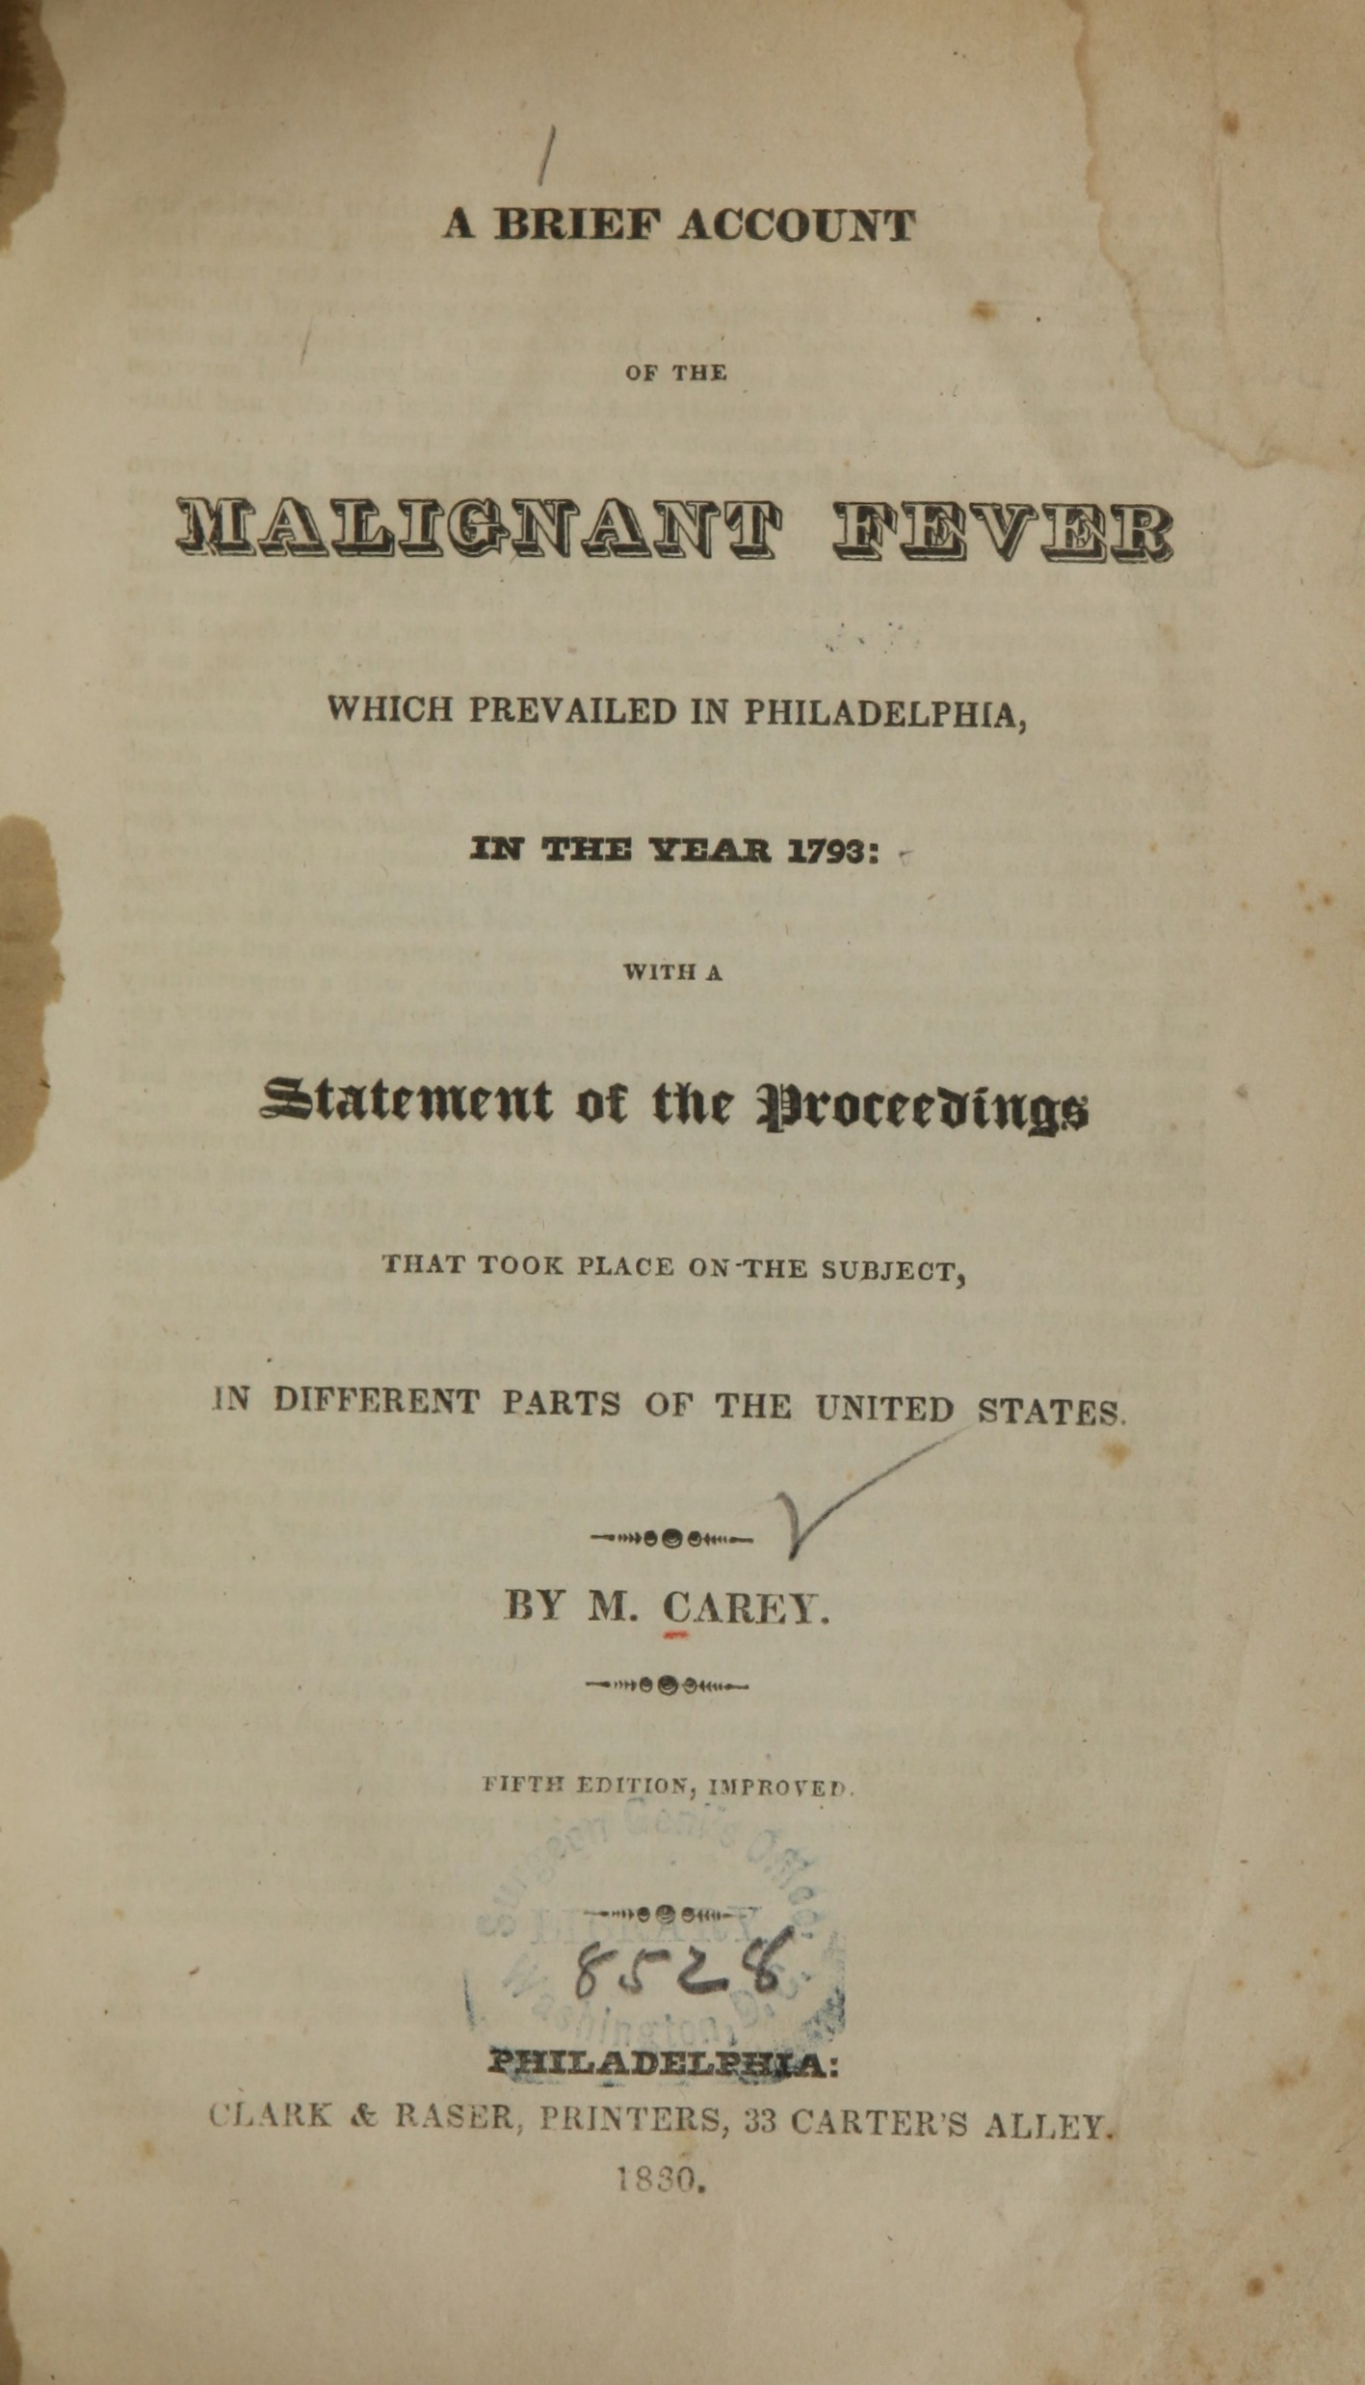
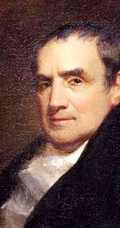
Mathew Carey was a publisher who wrote about the yellow fever in 1793.
Explore:
Explore his account and look up the symptoms, treatment, and prevention of yellow fever.
Hint: Chapter 2
https://collections.nlm.nih.gov/catalog/nlm:nlmuid-0140550-bk
This Photo by Unknown Author is licensed under CC BY-SA
Notes:
https://collections.nlm.nih.gov/catalog/nlm:nlmuid-0140550-bk

Slide 15
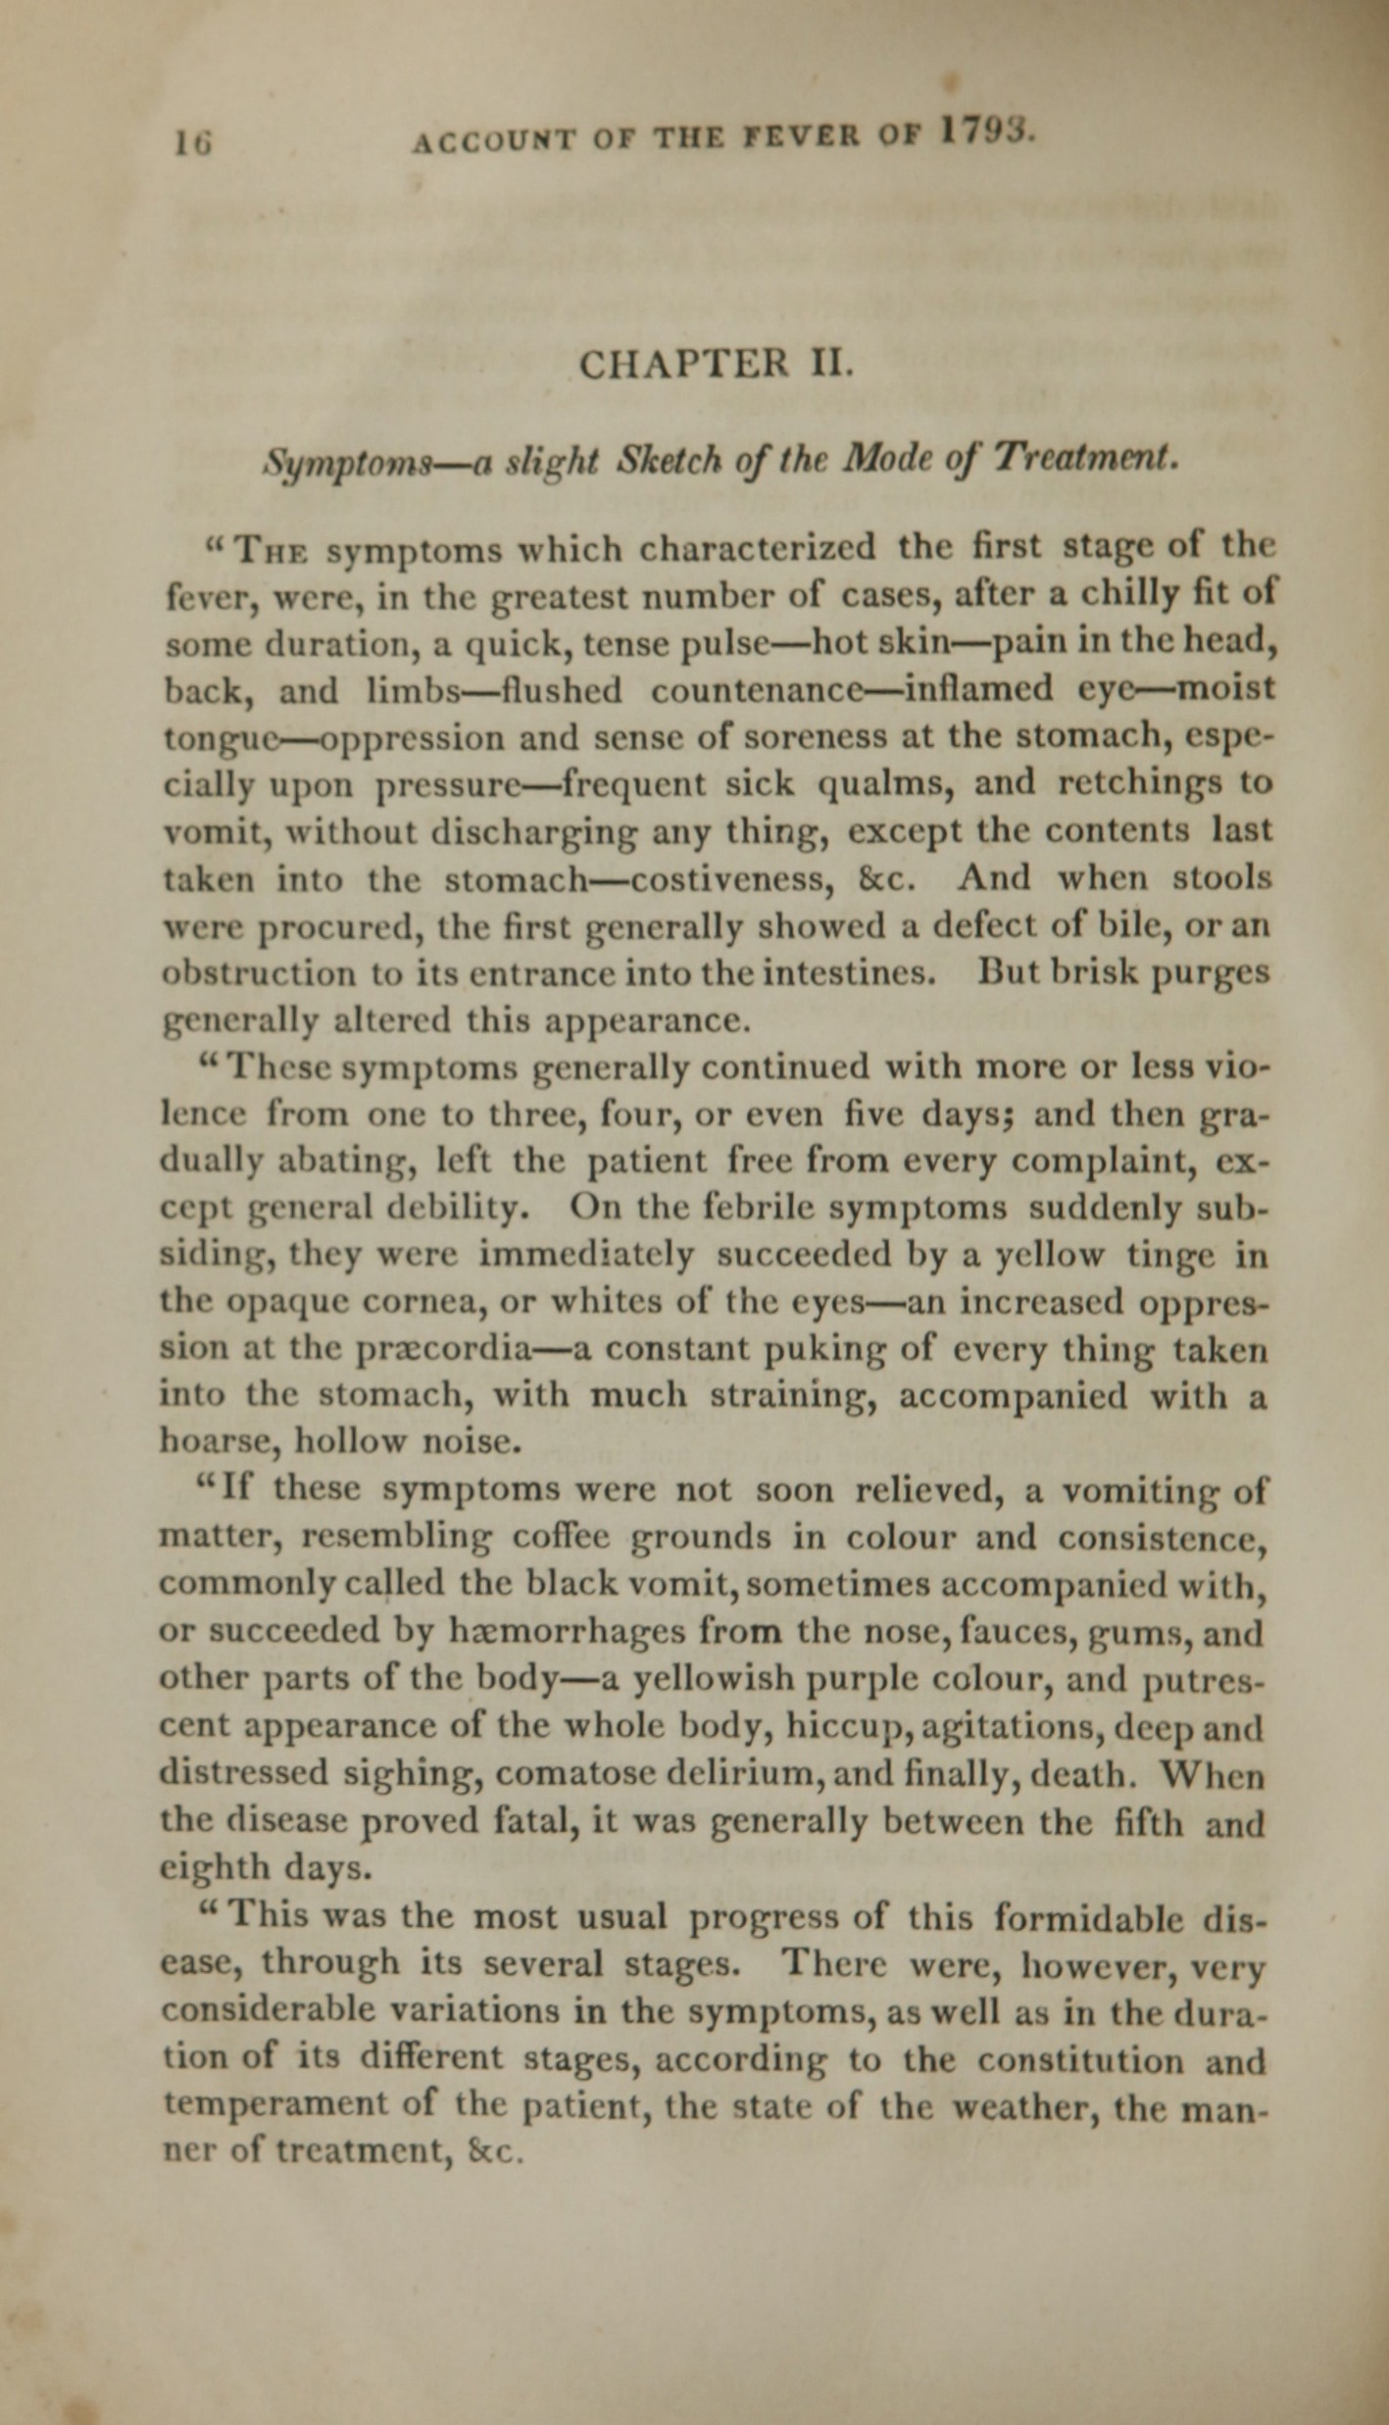
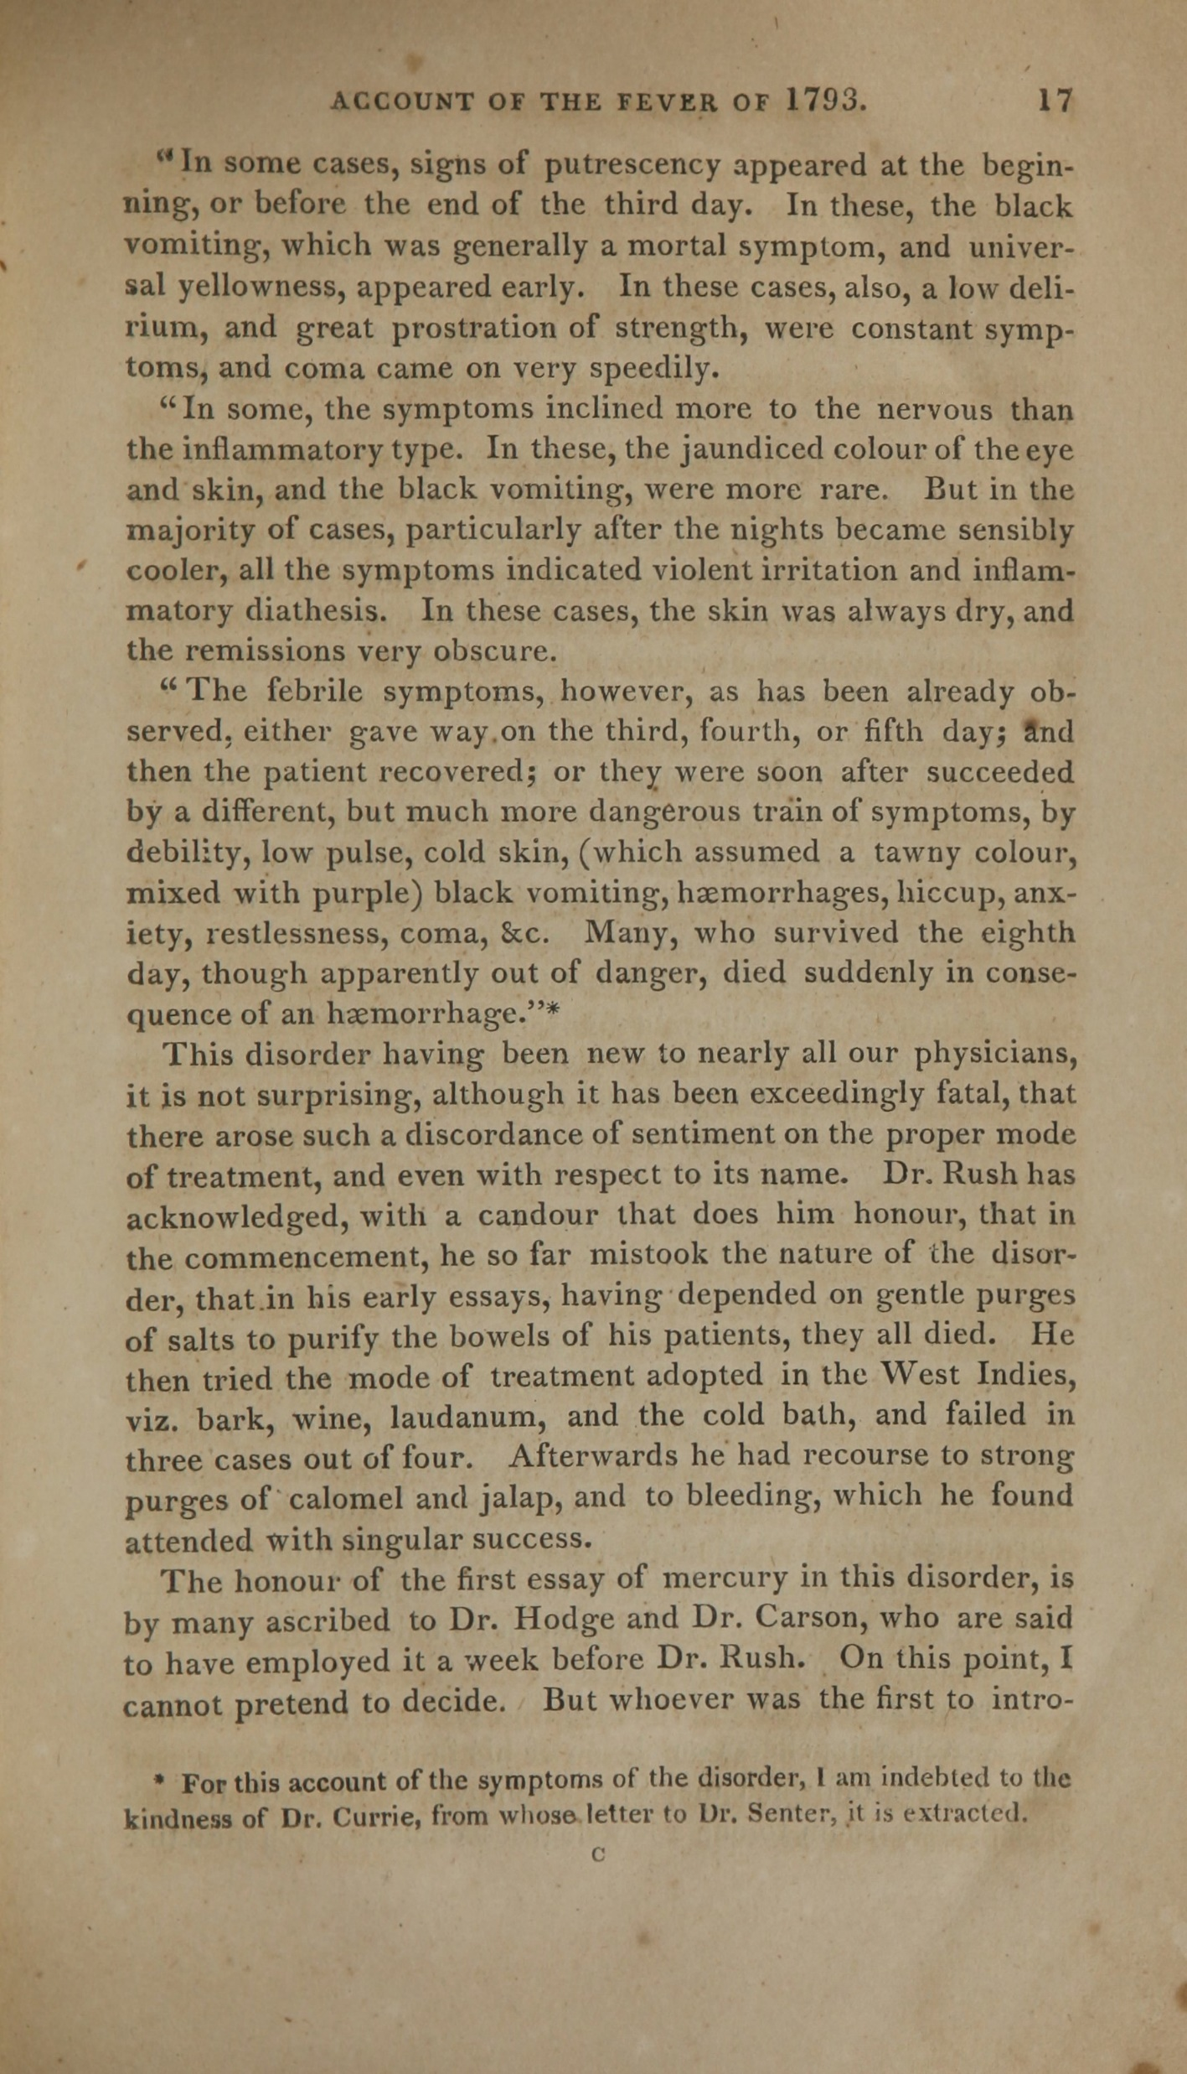
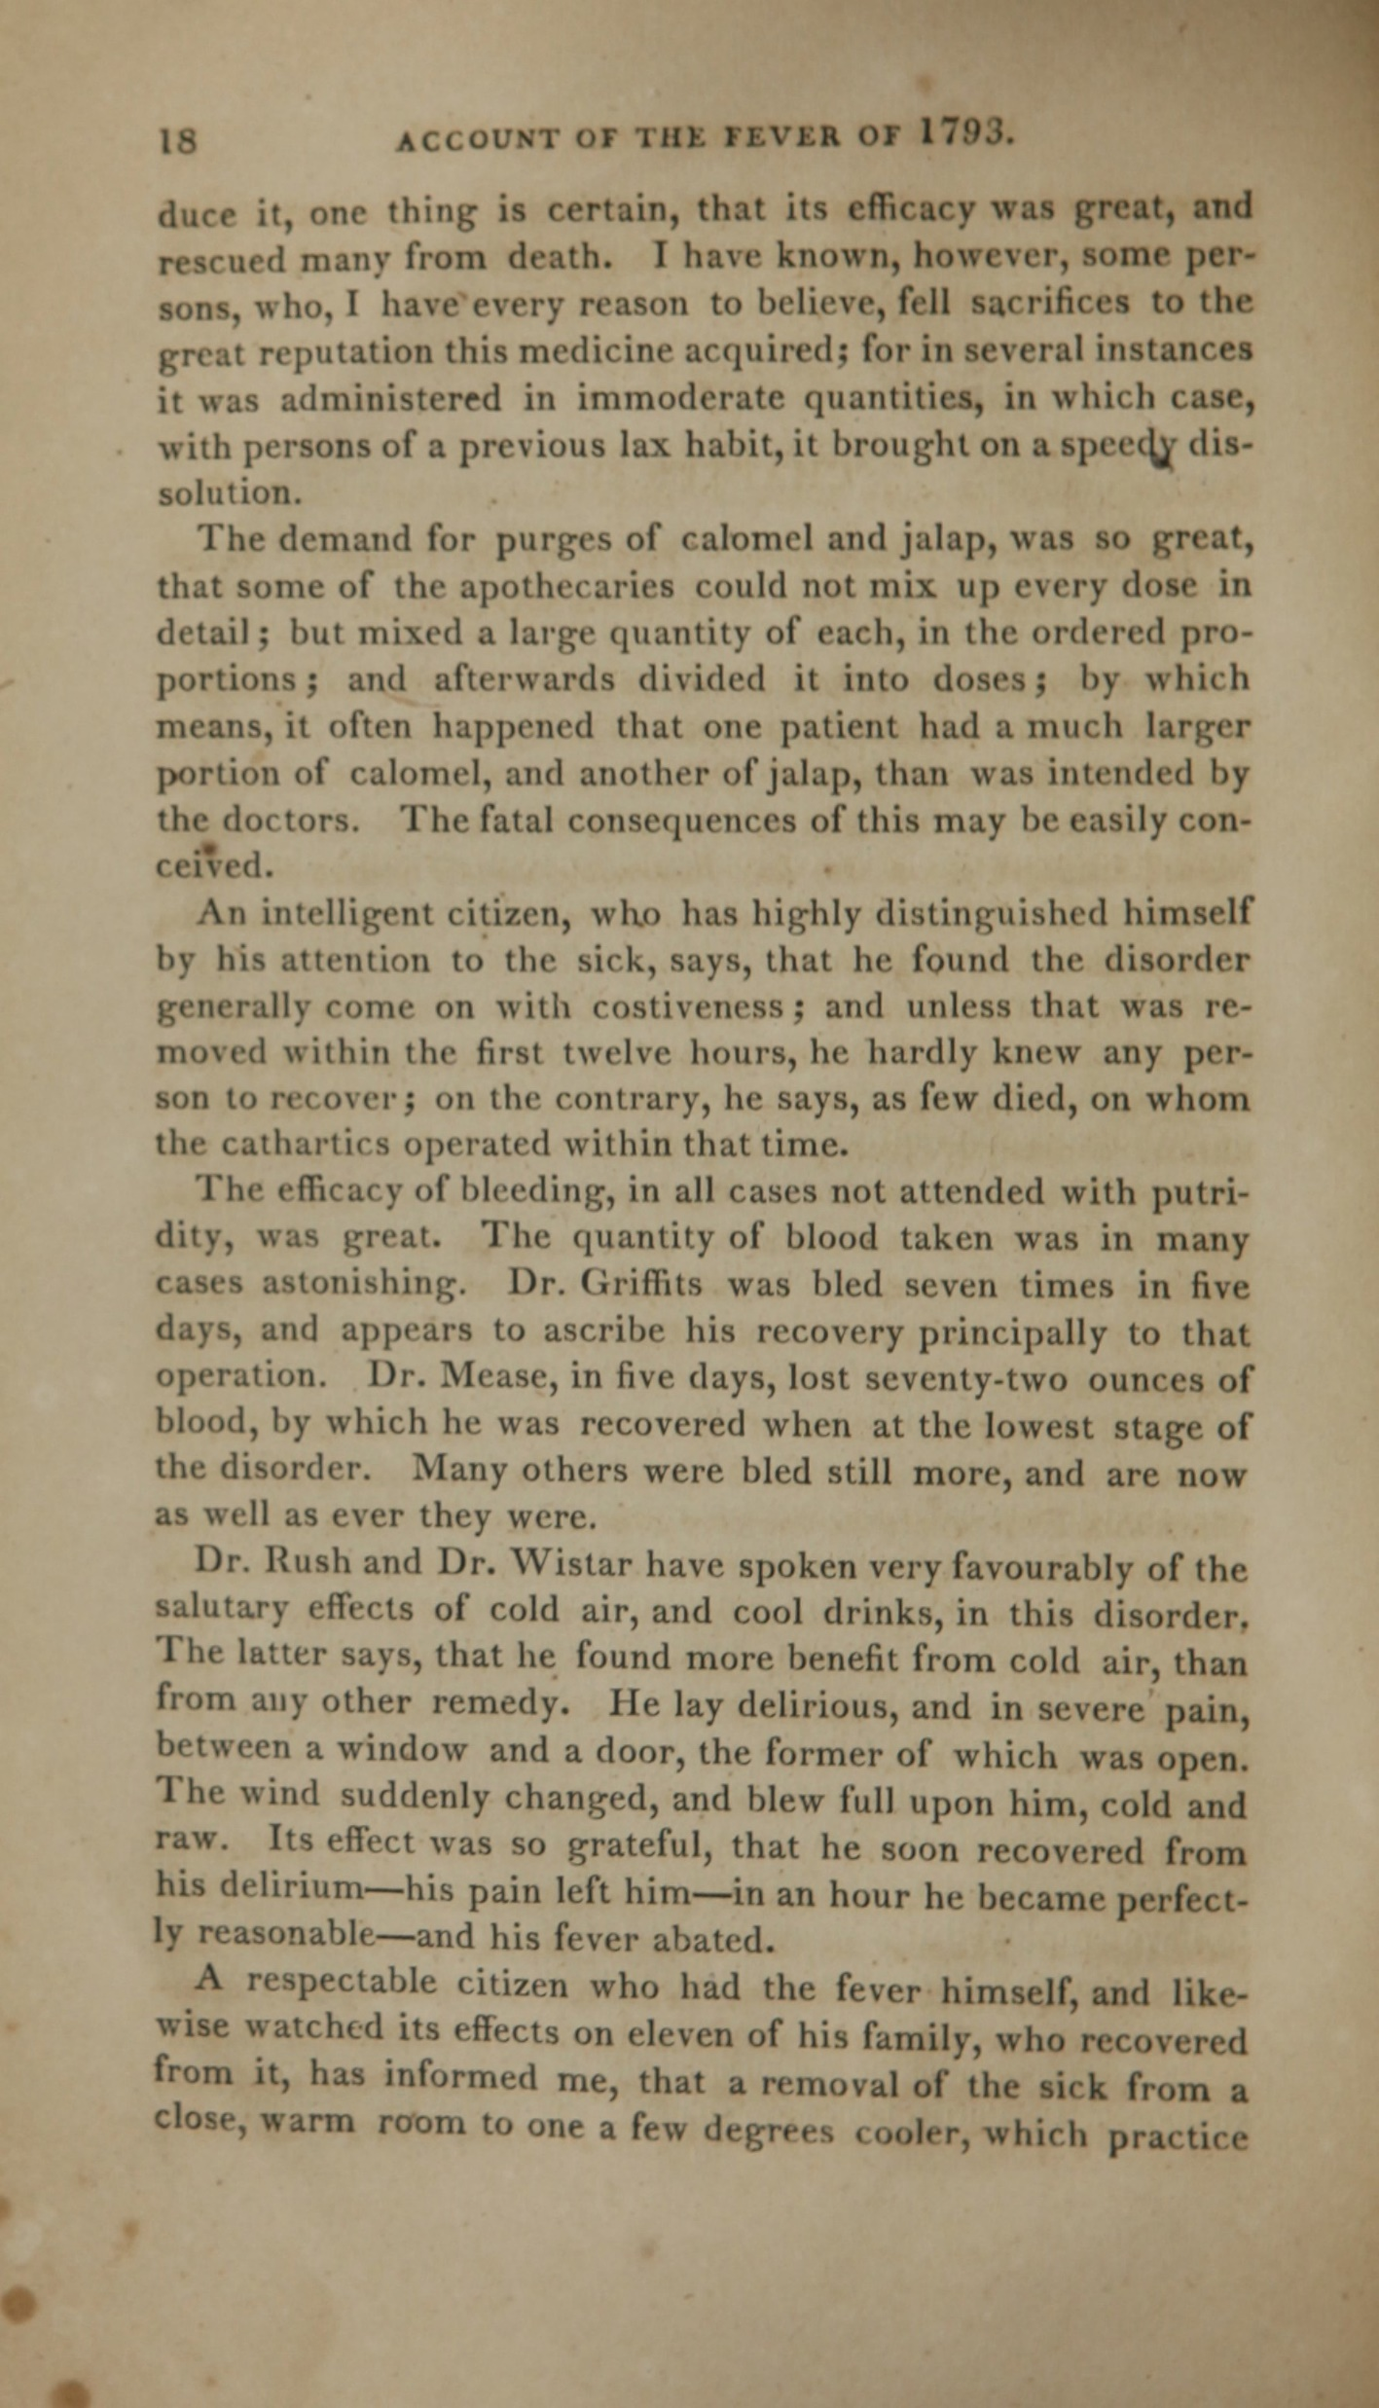
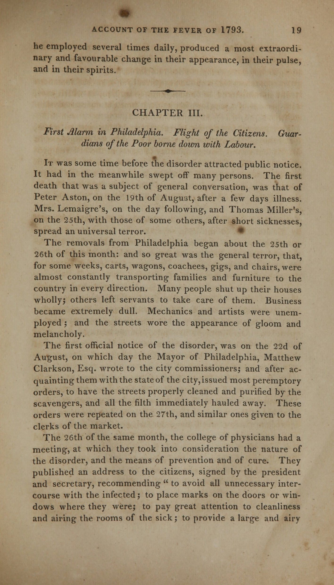
Notes:
https://collections.nlm.nih.gov/catalog/nlm:nlmuid-0140550-bk

Slide 16
Create a Chart
Then look up symptoms, treatment, and prevention about COVID-19 online.

Slide 17
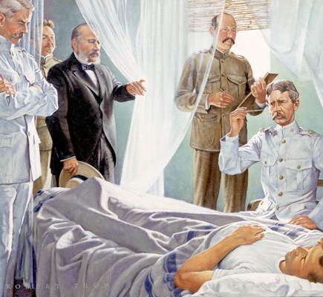
Important Dates
According to The History of Vaccines:
1900: The U.S. Army researchers did experiments and determined that “the mosquitoes could transmit the disease only after a certain period of time had passed since they had fed on another human infected with it (in the range of 12-20 days) and that a victim bitten by an infected mosquito would typically fall ill within six days.”
1936: Max Theiler and his colleagues developed a vaccine.
Today: There is no treatment or cure for yellow fever yet.
https://www.historyofvaccines.org/timeline/yellow-fever
This Photo by Unknown Author is licensed under CC BY-NC
Notes:
https://www.historyofvaccines.org/timeline/yellow-fever

Slide 18
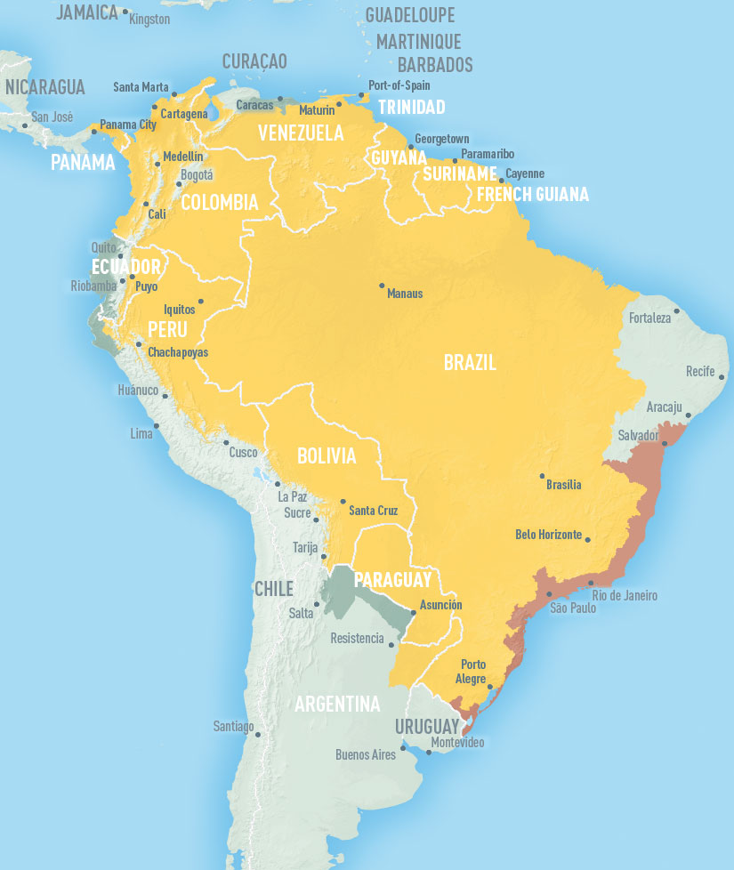
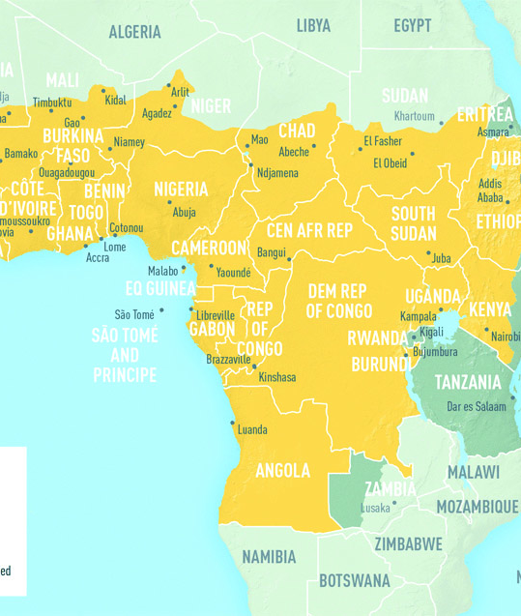
Yellow Fever Today
According to Centers for Disease Control and Prevention (CDC):
Yellow fever is found in certain areas in South America and Africa.
Bug repellent and long sleeves and pants are preventive measures.
Vaccine may be required to visit certain countries in at-risk areas.
https://www.cdc.gov/yellowfever/index.html
https://www.cdc.gov/yellowfever/maps/index.html
Notes:
https://www.cdc.gov/yellowfever/maps/index.html
https://www.cdc.gov/yellowfever/index.html

Slide 19
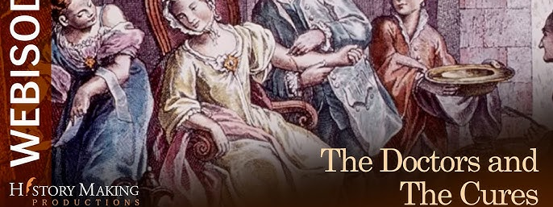
Fever: 1793 – The Doctors and the Cures
https://www.youtube.com/watch?v=W9tjV2h5jao
Notes:
https://www.youtube.com/watch?v=W9tjV2h5jao

Slide 20
Questions:
What were the two schools of thought on the cures for yellow fever?
How do you feel about these cures?
What ended yellow fever in 1793?
This Photo by Unknown Author is licensed under CC BY-NC

Slide 21
These plans were developed by Chen Chang as a Drexel University Capstone MLIS project in conjunction with Christ Church Preservation Trust and the CLIR funded Digitizing Philadelphia’s Historic Congregations project: www.philadelphiacongregations.org.

