Slide 1
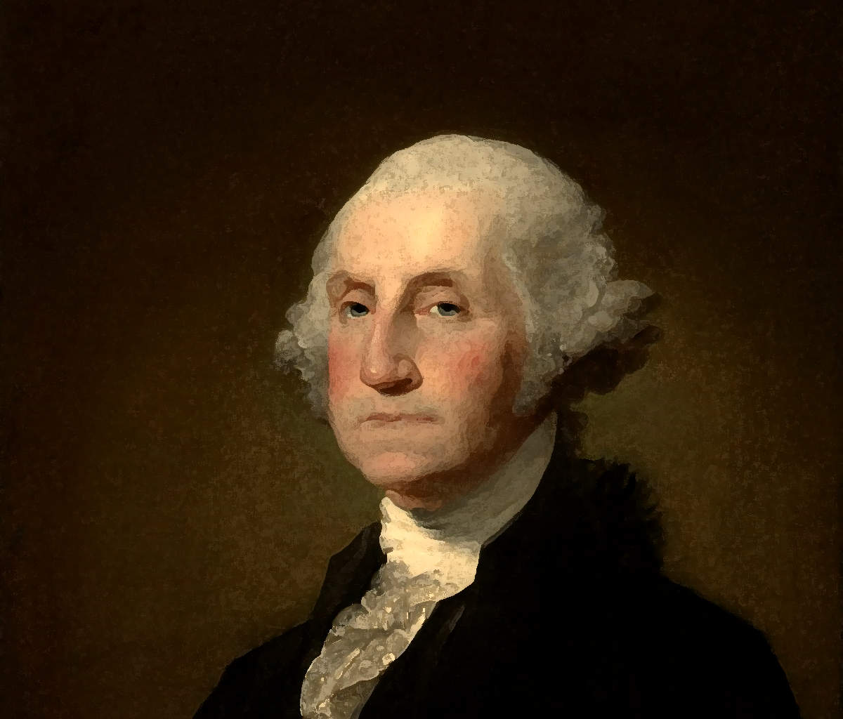
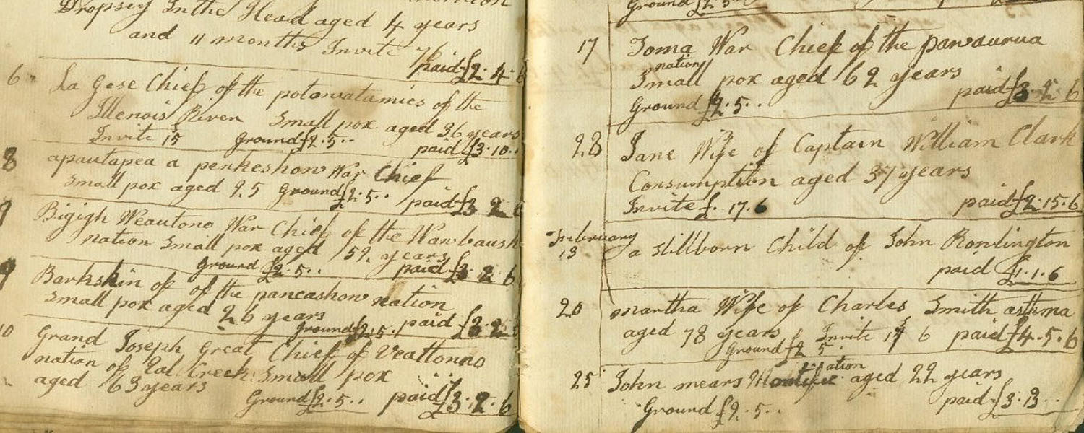
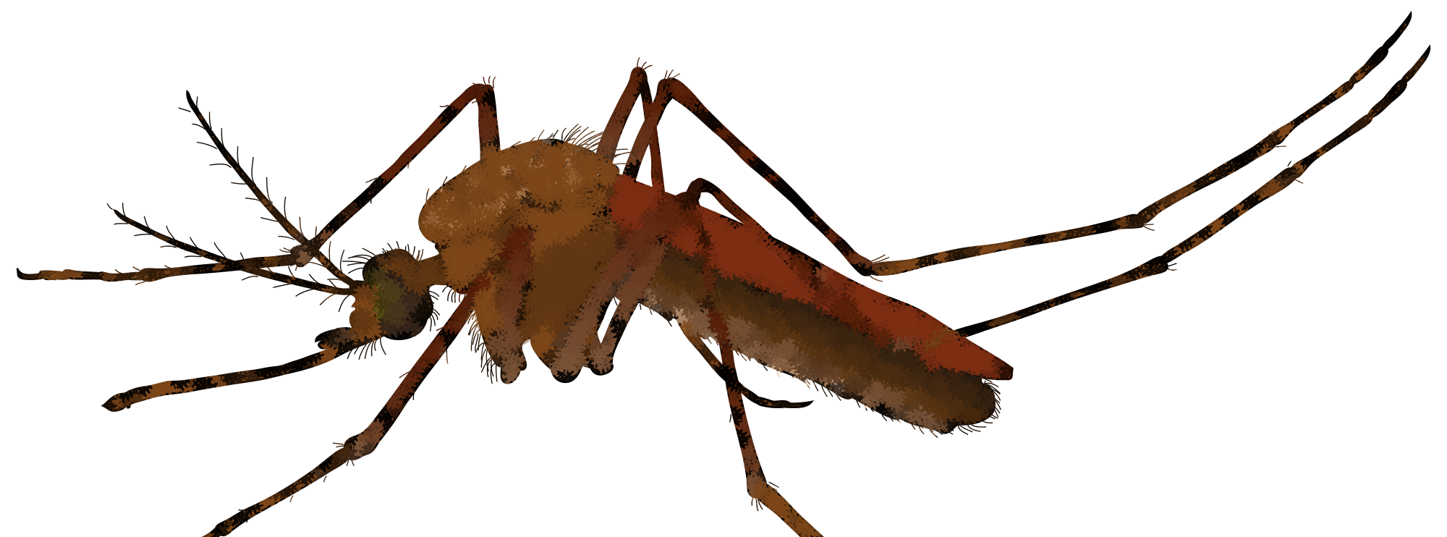
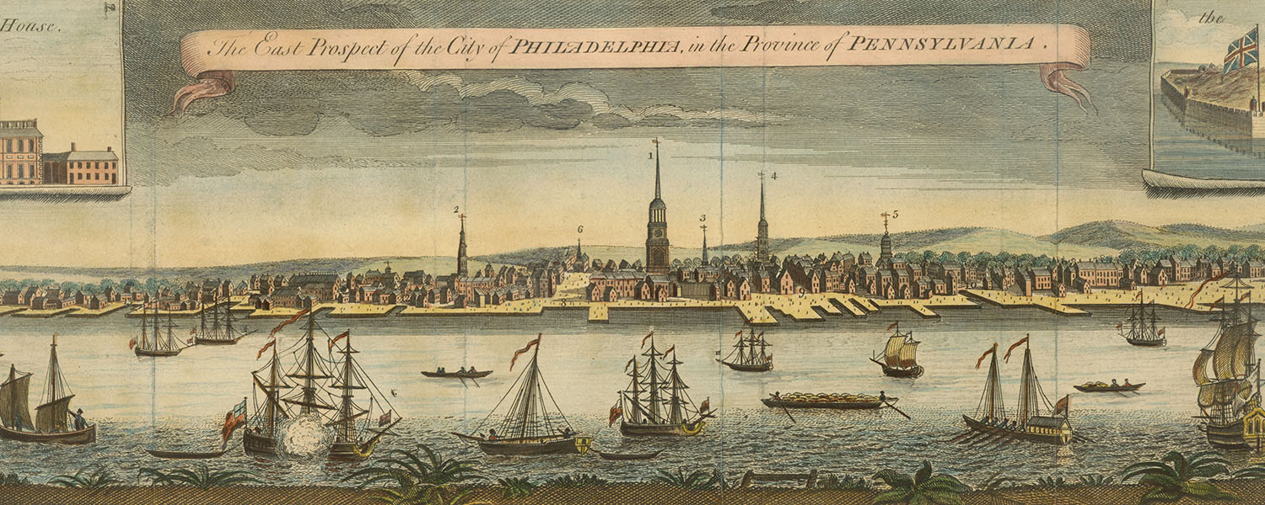
Yellow Fever and Leadership
Day 6
https://philadelphiacongregations.org/records/
This Photo by Unknown Author is licensed under CC BY-SA
This Photo by Unknown Author is licensed under CC BY-NC
This Photo by Unknown Author is licensed under CC BY

Slide 2
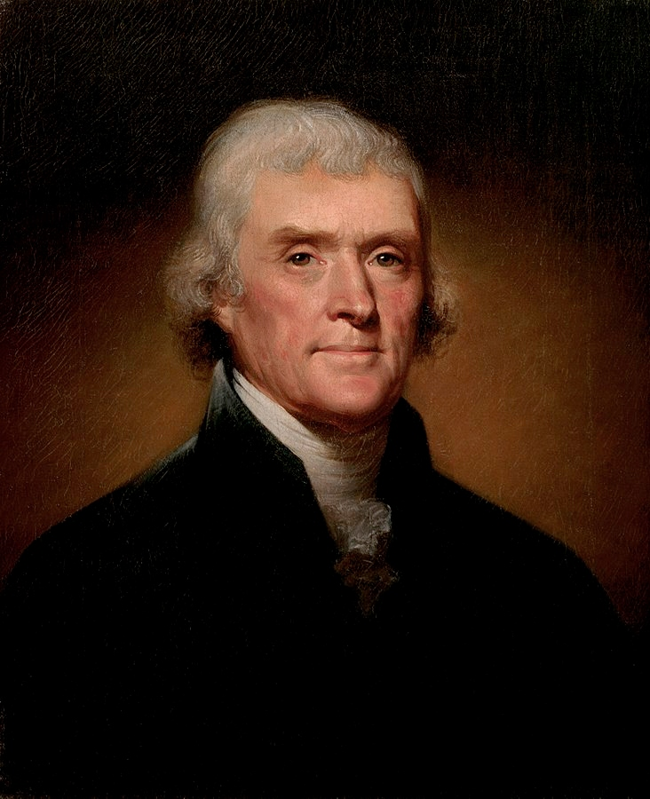
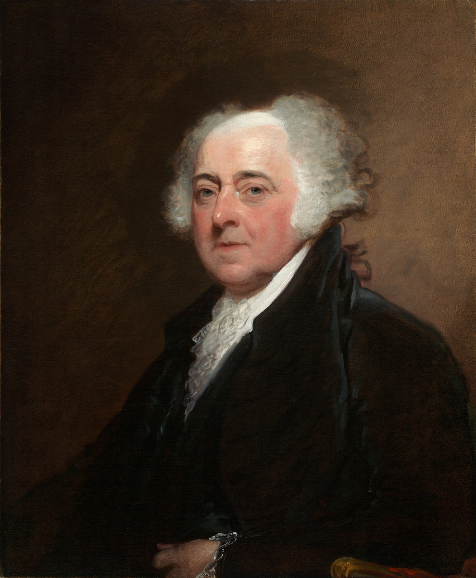
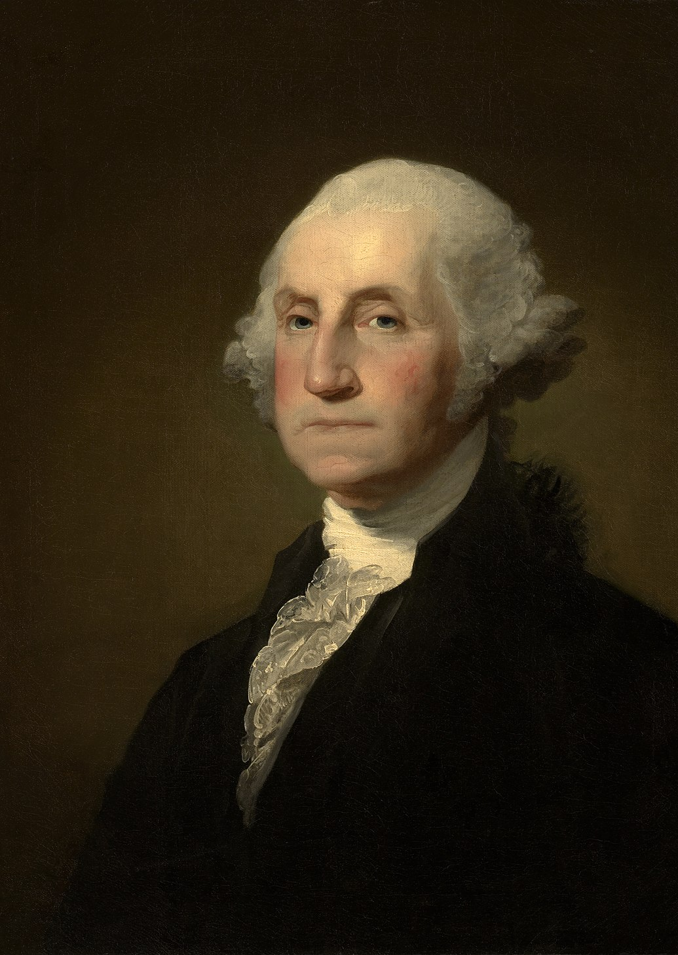
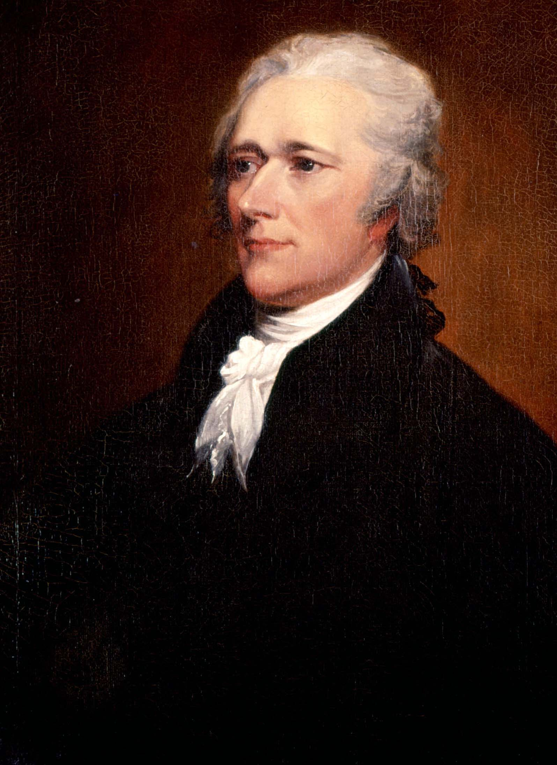
Important figures in the government left Philadelphia during the yellow fever in 1793
Do you recognize these men?
Jefferson • Adams • Washington • Hamilton
Who was the president of the United States?
This Photo by Unknown Author is licensed under CC BY-SA
This Photo by Unknown Author is licensed under CC BY-SA
This Photo by Unknown Author is licensed under CC BY-SA
This Photo by Unknown Author is licensed under CC BY-SA

Slide 3
Others stayed behind to fight the epidemic
“It’s always an extreme crisis that the true leaders emerge and what defines them is the ability to turn despair into opportunity.”
– “Fever (1793-1820) – Philadelphia: The Great Experiment”
What does this quote mean?

Slide 4
BINGO
George Washington
Governor Mifflin
Jean Deveze
Matthew Clarkson
Richard Allen
Sarah Bass
Stephen Girard
The Free African Society (black volunteers)
William Currie
Absalom Jones
Anne Parrish
Benjamin Latrobe
Benjamin Rush
Bush Hill
Churches
College of Physicians
Doctors
Frederick Graff
These 18 names appear in the video you will watch.
Select 16 names and randomly fill in the top blanks of your board.
As you watch the video, fill in the role for each figure.
You win BINGO when you correctly complete a row, column, or diagonal!
You win BLACKOUT BINGO when you correctly complete the whole board!
Notes:
“Yellow Fever Bingo Worksheet” goes along with this slide.

Slide 5
Fever (1793-1820)
https://www.youtube.com/watch?v=P7L5olIfYcI
Notes:
https://www.youtube.com/watch?v=P7L5olIfYcI

Slide 6
Let’s go over the roles

Slide 7
Absalom Jones
He didn’t believe Blacks were immune to yellow fever.
He believed volunteering would strengthen the Blacks’ case for equality and recognition.
He mobilized scores of people to treat the sick and dying.
https://commons.wikimedia.org/wiki/File:Absalom-Jones_Peale.jpg

Slide 8
Anne Parrish
She established the House of Industry that trained yellow-fever surviving women and orphan girls in needle trade and loom work to support themselves and their families.
https://prabook.com/web/show-photo.jpg?id=2616701&cache=false

Slide 9
Benjamin Latrobe
He was an engineer who was commissioned to design the first municipal water system.
He used steam power to provide fresh water, but it was dangerous.
https://commons.wikimedia.org/wiki/File:Benjamin_latrobe_by_peale.jpg

Slide 10
Benjamin Rush
He thought the cause of yellow fever was bad air.
He believed Blacks were immune to yellow fever.
He persuaded Allen and Jones to organize Blacks to serve stricken whites.
He believed in aggressive intervention like purging with mercury and bloodletting.
He treated more than 100 people a day.
https://commons.wikimedia.org/wiki/File:Benjamin_Rush_Painting_by_Peale.jpg

Slide 11
Bush Hill
It was a place of healing.
It was a place of cleanliness, nourishment, and good care.
It was a haven.
https://philadelphiaencyclopedia.org/wp-content/uploads/2016/08/7485_ca_object_representations_media_21165_mediumlarge.jpg

Slide 12
Churches
They buried some of the dead in their cemeteries.
https://www.christchurchphila.org/history/

Slide 13
College of Physicians
It built on a century of innovation, experimentation, and science to avoid future catastrophic threats.
http://muttermuseum.org/about/the-college-of-physicians-of-philadelphia/

Slide 14
Doctors
They became the authority after those in the government left.
They were at odds over the cause of yellow fever.
They had different ideas of treatment.
https://www.youtube.com/watch?v=W9tjV2h5jao

Slide 15
Frederick Graff
He was Benjamin Latrobe’s protégé.
He designed a technologically innovative system to lift water from the river to a reservoir.
https://commons.wikimedia.org/wiki/File:Frederic-Graff-portrait-cropped.jpg

Slide 16
George Washington
He was the president of the United States.
He left Philadelphia.
He laid the symbolic cornerstone of the new capital on the way to Mt. Vernon.
https://commons.wikimedia.org/wiki/File:Gilbert_Stuart_Williamstown_Portrait_of_George_Washington.jpg

Slide 17
Governor (Thomas) Mifflin
He shut down the state assembly.
https://commons.wikimedia.org/wiki/File:Thomas_Mifflin.jpg

Slide 18
Jean Deveze
He was the chief physician at Bush Hill.
https://archive.org/details/2551045R.nlm.nih.gov

Slide 19
Matthew Clarkson
He was a mayor who formed a committee of volunteers to guide Philadelphia’s response to the crisis.
https://commons.wikimedia.org/wiki/File:Matthew_Clarkson_(NYPL_b12349196-420205)_(cropped).jpg

Slide 20
Richard Allen
He didn’t believe Blacks were immune to yellow fever.
He believed volunteering would strengthen the Blacks’ case for equality and recognition.
He mobilized scores of people to treat the sick and dying.
https://commons.wikimedia.org/wiki/File:Richard_Allen_crop.jpg

Slide 21
Sarah Bass
She was a Black volunteer who treated the sick and dying.
https://commons.wikimedia.org/wiki/File:Sara_Brown_-_only_portrait.jpg

Slide 22
Stephen Girard
He volunteered to take over the management of the makeshift hospital at Bush Hill, transforming it from a place of squalor and horror into a fully functioning hospital.
He disagreed with Benjamin Rush’s treatments.
He served as nurse, orderly, and source of comfort for the ill and dying.
https://commons.wikimedia.org/wiki/File:Stephen_Girard_by_JR_Lambdin.jpg

Slide 23
The Free African Society (black volunteers)
They volunteered to treat the sick and dying.
https://www.blackpast.org/african-american-history/free-african-society-philadelphia-1787/

Slide 24
William Currie
He was an opponent of Benjamin Rush and thought Rush was mistaken about the cause of yellow fever.
He advocated a palliative regimen – to heal the body naturally through bed rest and diet.
https://collections.nlm.nih.gov/catalog/nlm:nlmuid-2551045R-bk

Slide 25
What If?
What if some of these important figures like Washington, Adams, Jefferson, and Hamilton had stayed in Philadelphia?
What if they caught yellow fever?
How would that have changed the course of the United States?
This Photo by Unknown Author is licensed under CC BY-NC-ND

Slide 26
3-2-1 Exit Tickets
Write 3 things you learned from this yellow fever unit.
Write 2 things you liked or found interesting.
Write 1 question you have.

Slide 27
These plans were developed by Chen Chang as a Drexel University Capstone MLIS project in conjunction with Christ Church Preservation Trust and the CLIR funded Digitizing Philadelphia’s Historic Congregations project: www.philadelphiacongregations.org.

