Slide 1
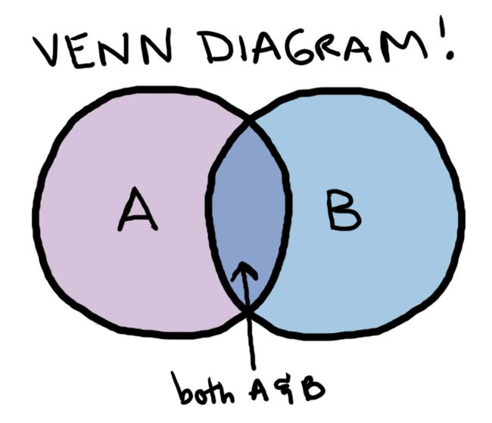
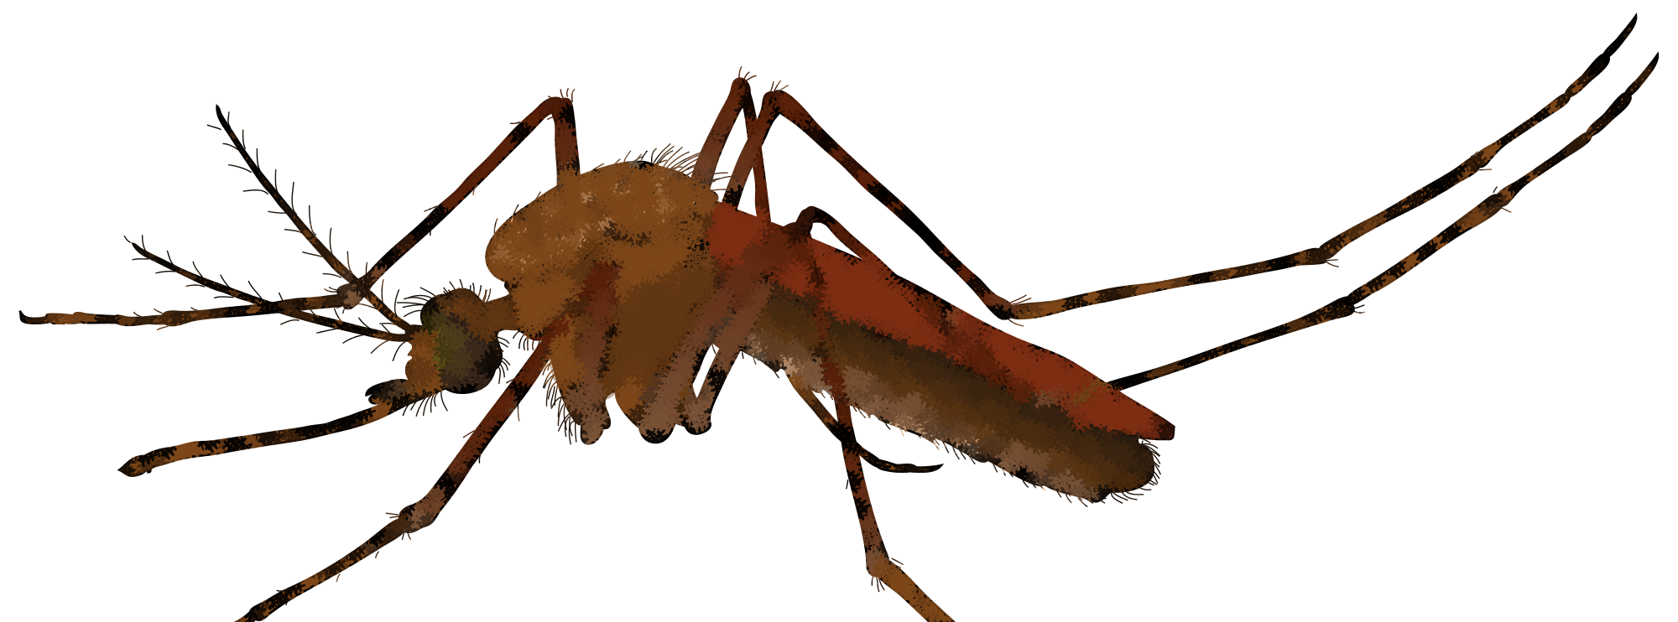
Compare and Contrast Essay
Day 7
This Photo by Unknown Author is licensed under CC BY-NC
This Photo by Unknown Author is licensed under CC BY-SA
This Photo by Unknown Author is licensed under CC BY-SA-NC
This Photo by Unknown Author is licensed under CC BY-NC-ND

Slide 2
Review Popular Exit Tickets
(Fill in some of your students’ exit tickets and talk about things they have learned, things they liked or found interesting, and questions they have.)
Notes:
Teachers should add their students’ tweets into these slides!

Slide 3
Essay
Write an essay that compares and contrasts any topic related to the yellow fever epidemic, whether it’s something you have learned or want to know more about.
It should be 2 – 3 pages.
It is due on (__________).
This Photo by Unknown Author is licensed under CC BY-SA
Notes:
Teachers should fill in the due date.

Slide 4
Essay
Choose a topic. Examples include:
Mathew Carey vs. Richard Allen and Absalom Jones
Yellow fever vs. COVID-19
Church burial records
Primary sources about yellow fever
Primary sources vs. second sources about yellow fever
Different historical figures’ roles
Benjamin Rush vs. another doctor
The rich vs. the poor
White Americans vs. African Americans
Local government vs. national government
And more!
This Photo by Unknown Author is licensed under CC BY-NC-ND
Notes:
Teachers should fill in the due date.

Slide 5
Research Time
You have time now in class
to start researching your topic
and working on your essay.
REMEMBER
Write an essay that compares and contrasts any topic related to the yellow fever epidemic, whether it’s something you have learned or want to know more about.
This Photo by Unknown Author is licensed under CC BY

Slide 6
These plans were developed by Chen Chang as a Drexel University Capstone MLIS project in conjunction with Christ Church Preservation Trust and the CLIR funded Digitizing Philadelphia’s Historic Congregations project: www.philadelphiacongregations.org.

