Slide 1
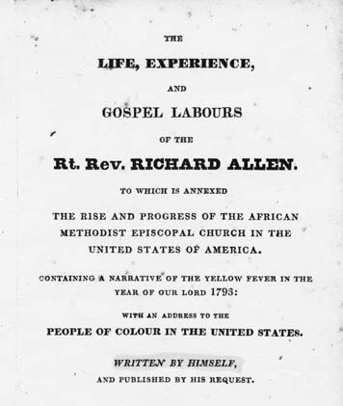
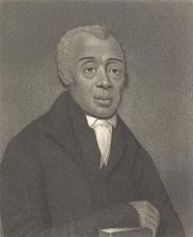
The Great Walkout
Day 3
https://docsouth.unc.edu/neh/allen/allen.html
This Photo by Unknown Author is licensed under CC BY-SA
This Photo by Unknown Author is licensed under CC BY-SA
This Photo by Unknown Author is licensed under CC BY-SA

Slide 2
Richard Allen: 1793: Apostle of Freedom
https://www.youtube.com/watch?v=9Zd-PuQZVFE
Watch up to the 2:57 mark.
Notes:
https://www.youtube.com/watch?v=9Zd-PuQZVFE

Slide 3
Questions:
Who was Richard Allen?
How was the Methodist Church equal in treating everyone?
Why did the walkout at St. George’s happen?
Why and how was the walkout the beginning of the civil rights movement in American Society?
This Photo by Unknown Author is licensed under CC BY-NC

Slide 4
Read:
“The Great Walkout…”
By The African Episcopal Church of St. Thomas
http://www.aecst.org/walkout.htm
Notes:
http://www.aecst.org/walkout.htm

Slide 5
Who, What, Where, When, Why, and How
In the AECST article, they include a passage from Richard Allen’s memoir about the walkout.
Write your own who, what, where, when, why, and how questions about the passage.
Then trade your questions with your partner to answer.
https://docsouth.unc.edu/neh/allen/allen.html
This Photo by Unknown Author is licensed under CC BY-SA
Notes:
https://docsouth.unc.edu/neh/allen/allen.html

Slide 6
Civil Rights Movement
Throughout African American history, there have been rebellions, sit-ins, marches, demonstrations, etc.
What other protests in history can you compare this walkout to?
Explore “Civil Rights Movement” by History.com editors.
https://www.history.com/topics/black-history/civil-rights-movement
This Photo by Unknown Author is licensed under CC BY-SA
Notes:
https://www.history.com/topics/black-history/civil-rights-movement

Slide 7
Essay
Write an essay that compares the great walkout to any civil rights event in history from the History.com article or another event not mentioned in the article.
Choose a civil rights event.
It should be 1 – 2 pages.
It is due on (__________).
This Photo by Unknown Author is licensed under CC BY-SA
Notes:
Teachers should fill in the due date.

Slide 8
Research Time
You have time now in class
to start researching your event
and working on your essay.
REMEMBER
Write an essay that compares the great walkout to any civil rights event in history from the History.com article or another event not mentioned in the article.
This Photo by Unknown Author is licensed under CC BY

Slide 9
These plans were developed by Chen Chang as a Drexel University Capstone MLIS project in conjunction with Christ Church Preservation Trust and the CLIR funded Digitizing Philadelphia’s Historic Congregations project: www.philadelphiacongregations.org.

